Slide 1
Distributed Video Analytics using Kafka & Faust
Jeevithiesh Duggani
Sasanka Sekhar Sahu

Slide 2
Motivation: Fast Data Processing
Many modern systems require data to be processed as soon as it becomes available i.e., real-time.
E-commerce sites processes product clicks for recommendation
In finance domain, analyse transactions into fraudulent or genuine
Social media applications analysing likes/comments
One compelling use-case of fast data Processing: Streaming Analytics
Inferencing/Predictive Analysis over streams of data
Apache Kafka: Distributed event-store & stream-processing platform

Slide 3
Motivation: Video Analytics
Video Surveillance,
Autonomous Vehicles,
Behavior Detection,
Person Tracking, and many more.
In this project, we build a distribution video streaming analytics pipeline.

Slide 4
Apache Kafka
Real-time event stream processing system for big data.
Concepts:
Broker: Single Kafka Server.
Producers: Write to topics.
Consumers: Subscribe to topics and read messages from it.
Partitions within topics. Ordering preserved within partitions.
Broker Cluster: Multiple Brokers. Replicated Partitions.
Zookeeper for coordination.

Slide 5
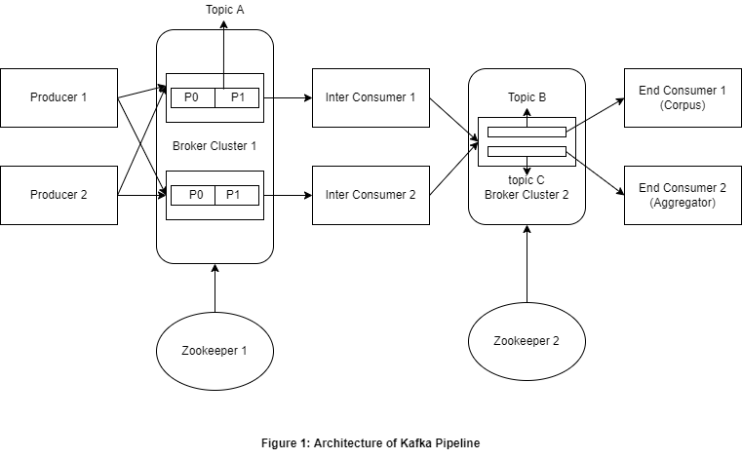
Architecture of Kafka Pipeline

Slide 6
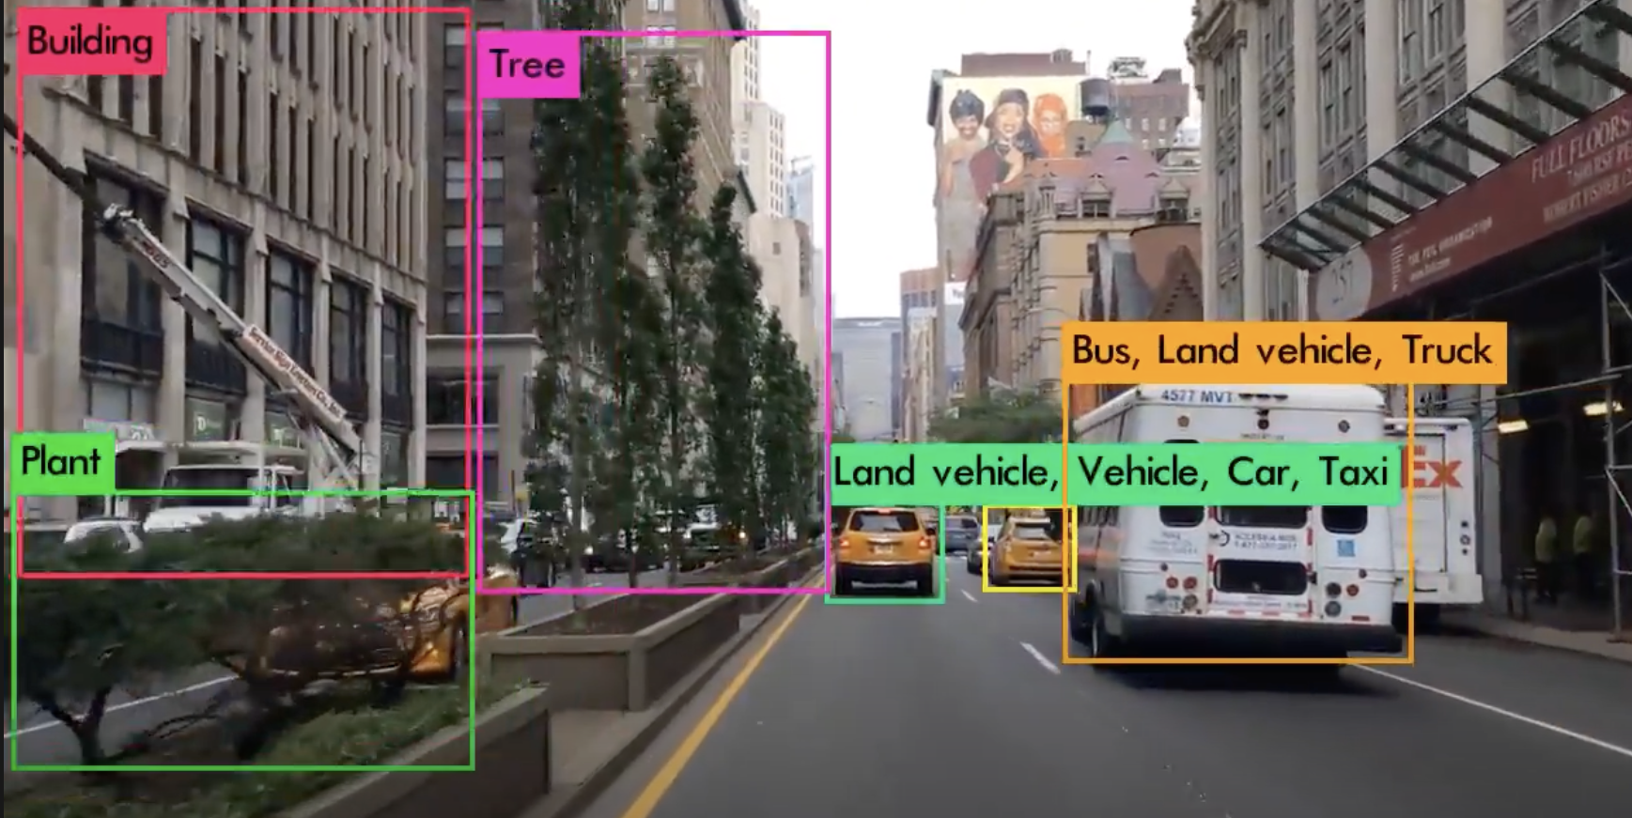
Analytics
Intermediate Consumer/Producer:
Inferencing using pre-trained Yolov5 model
Output <frame, bounding boxes> to Topic B and Topic C.

Slide 7




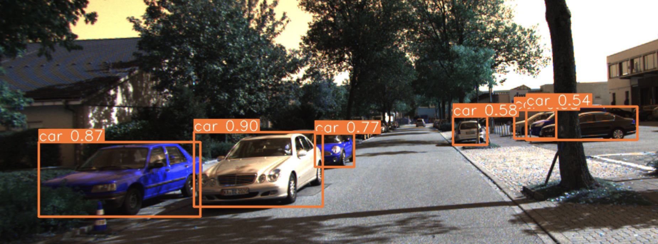
Analytics
Traffic Lights:
End Consumer 1:
Corpus of images per label
End Consumer 2:
Vehicle count per frame
Cars:
Count: 7

Slide 8
Inferencing: Yolov5
Background on object detection:
Two-stage detection: R-CNN, Fast R-CNN, Faster R-CNN
One-stage detection: Yolo
Till Yolov3, Faster R-CNN more accurate than Yolo but slower.
Yolov4, Yolov5: Accuracy comparable to two stage detectors + faster.
We use pre-trained Yolov5s model. Trained on COCO dataset.

Slide 9
Datasets
Considered the following:
VIRAT Video Dataset
Waymo Open Dataset
BOSCH Boxy-Dataset
KITTI Vision Benchmark Suite Video Dataset
ImageNet Video Visual Relation Dataset

Slide 10
Implementation
In python, using Kafka-python library.
Producer:
KafkaProducer
OpenCV for reading video and publishing frames
Compression: Snappy
‘linger_ms’ set to 5. Waits before pushing.
Publish every third frame to Topic A.
IP and port of brokers explicitly set as configuration parameter.

Slide 11
Implementation
Intermediate Consumer/Producer
Consumer Configs:
Topic, Group, broker IP & port, etc.
Yolov5 model from Pytorch
Pre-trained weights downloaded to file-system
Outputs results as a list of bounding boxes, label & confidence
Publish (image, result) to Topic B and (result) to Topic C.
End Consumers
Configs above.
Uses threshold to filter low-confidence predictions

Slide 12
Kafka Streams
A Stream is an unbounded and continuously updating data set.
Streams are ordered, replayable and fault tolerant sequence of immutable data records, where a data record is a <key, value> pair.
Kafka Streams is a client library for processing and analyzing the data stored in Kafka.
Kafka Streams implements streaming concepts like windowing, event and processing time etc. in Kafka.

Slide 13
Faust
Faust is a streaming processing library that uses ideas from Kafka Streams in Python.
As it does not use a Domain Specific Language (DSL), it can implement many of the popular Python libraries like NumPy, Pytorch etc.
Operations such as Join, Outer Join and Left Join which are implemented in Kafka Streams are not implemented in Faust.
Faust uses RocksDB, a super fast embedded database written in C++ to implement KTables.

Slide 14
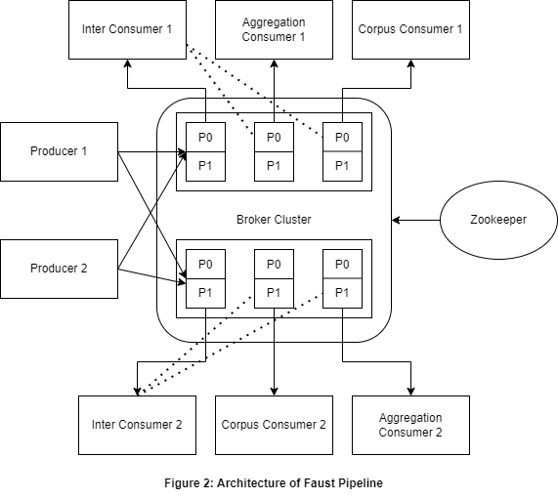
Architecture of Faust Pipeline

Slide 15
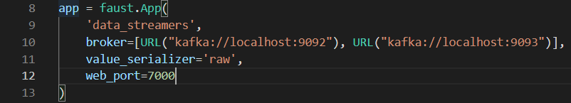
Implementation
The faust.App provides the Core API of Faust.
In order to create an application, the application name (group-id) and a list of brokers to connect are to be mentioned.
Each new faust application is to be opened on new webport when opened on a same device.

Slide 16
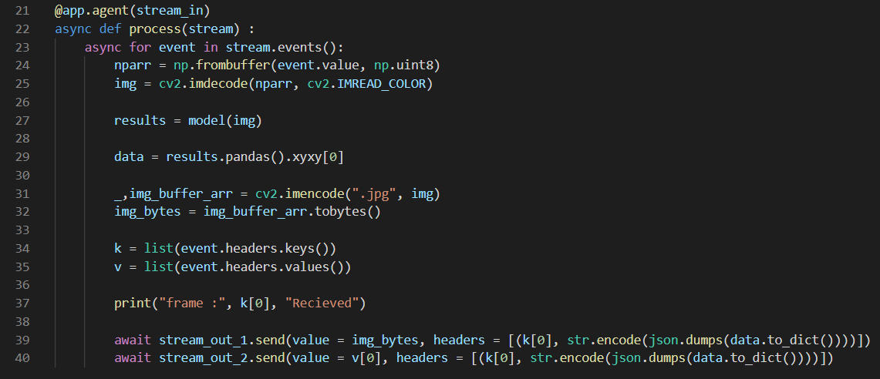
Implementation
The Agent decorator defines the Stream Processor.
The stream processor takes in the messages from the topic defined by stream_in.
A stream processor can also output to several topics as shown here.

Slide 17
Implementation
Faust also implements a Table that is an in-memory dictionary, that is also backed by a Kafka Changelog Topic for fault tolerance and persistence.
Can be only modified within a stream operation.
The Table is sharded among the workers that uses the Table and is replicated over the nodes, so on failure the data is not lost.
We have implemented the table in the Aggregation Consumer where the table maintains the number of vehicles detected according to their type.

Slide 18
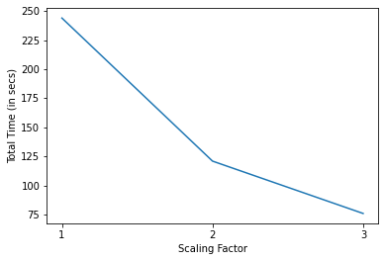
Results
Strong Scaling
One Producer
Scale the Inter Consumers and the End Consumers and measure the total time taken for all the messages to be read.

Slide 19
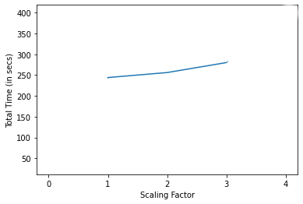
Results
Weak Scaling
Scale the Producer, Inter Consumers and the End Consumers.
As each Producer outputs the same amount of data, the data also scales with the number of Producers.

Slide 20
Challenges
Implementation of the pipeline across different machines
Achieving scalability by running multiple consumers and stream processors.

Slide 21
Future Work
Experimenting with batches and input rate: Identifying optimal value.
More Involved Analytics
Human Activity Recognition
Identifying stationary vs. moving object
Implementing the values of the Messages in Kafka as Faust.Record
Implementing Streaming specific analytics like windowing.

Slide 22
References
Apache Kafka Streams
Faust - Python Stream Processing — Faust 1.9.0 documentation

Slide 23
Thank You

